Slide 1
Big Mountain Resort Executive Presentation
Guided Capstone Project

Slide 2
Problem Identification
Big Mountain Resort aims to increase revenue by 20% within the next financial year by setting more competitive and profitable ticket prices.
Key Factors: Ticket pricing, visitor distribution, facility utilization, and cost-cutting measures.

Slide 3
Recommendation and Key Findings
Recommendation: Increase ticket prices gradually to align more closely with the model's suggested price of $95.87.
Key Findings: Potential undercharging, importance of vertical drop and chair lift expansion.

Slide 4
Modeling Results and Analysis
Initial Model: Baseline model provided minimal feature engineering.
Linear Regression: Good baseline performance but limited in capturing complex relationships.
Random Forest Regressor: Outperformed other models, handling complex non-linear relationships.

Slide 5
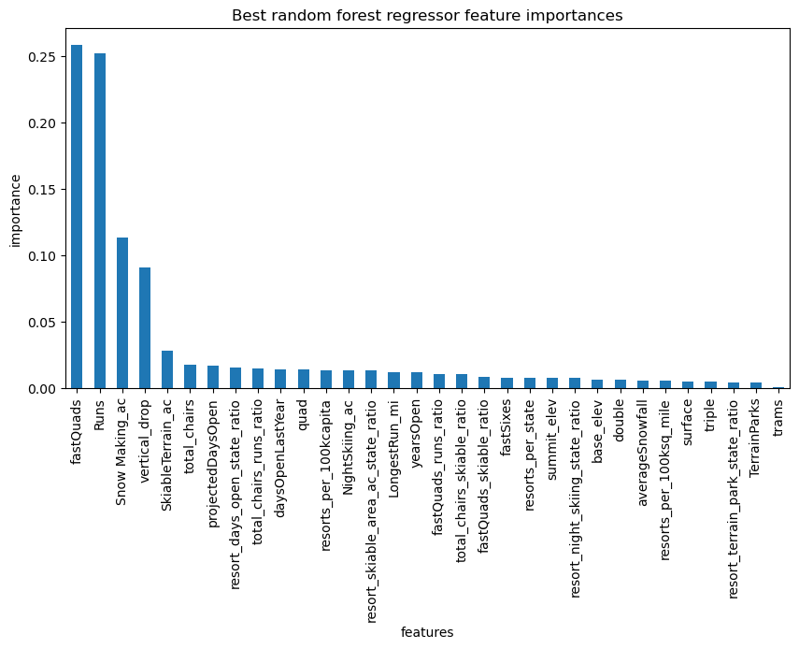
Random Forest Regressor Results
Key Features: Vertical drop, snow-making area, total number of chairs, fast quads, runs, longest run, trams, skiable terrain area.

Slide 6
Scenario Modeling
1. Closing Runs: Closing one run showed no impact on price, but more than three runs led to a significant price drop.
2. Vertical Drop and New Chair Lift: Increasing vertical drop and adding a chair lift supported a ticket price increase by $1.99.
3. Adding Snow-Making Area: No significant difference in ticket price increase.
4. Longest Run Extension: No significant impact on the ticket price.

Slide 7
Summary and Conclusion
Summary: Big Mountain Resort is potentially undercharging for its facilities.
Conclusion: Increase ticket prices gradually and consider expanding vertical drop and adding a new chair lift for a revenue increase.
Future Scope: Incorporate detailed cost data, competitor data, and customer satisfaction data to refine the model.

